Slide 1
CS 2212
Introduction to Software Engineering
Chapter 8 Requirements Modeling

Slide 2
Copyright Notice This Presentation and Its Associated Video Contain Copyright Material. This Presentation and Its Associated Video Are Provided for Teaching Purposes of CS2212 and Should Not Be Posted In Any External Site, Or Shared with. This Presentation and Its Associated Video Are Provided For Instructional Personal Use Only, and Only For The Purposes of the CS2212 Course.

Slide 3
Part 18
Behavioral Modeling Approach to Requirements Modeling and UML State Diagrams
Any fool can write code that a computer can understand. Good programmers write code that humans can understand.
--Martin Fowler
Notes:
This lesson introduces the basic steps in a software engineering project at a high level.
In practice, steps often overlap.

Slide 4
Learning Objectives in this Part
To understand the concept of specifying the behavior of Use Cases using States

Slide 5
Behavioral Modeling
A behavioral model indicates how software will respond to external events or stimuli
To create the model, the analyst must perform the following steps:
Evaluate all use cases to understand the sequence of interaction within the system
Identify events that drive the interaction sequence and understand how these events relate to specific objects
Create a sequence for each use case
Build an activity (or state) diagram for the system
Review the behavioral model to verify accuracy and consistency

Slide 6
Identifying Events With The Use Case
Generally, events occur whenever a system and an actor exchange some kind of information
An event is not the information that has been exchanged, but rather the fact that information has been exchanged
So, to identify events for behavioral modeling, use cases are examined for points of information exchange
For each event, an actor is identified; the information exchanged is noted; and any conditions or constraints are listed

Slide 7
Identifying Events With The Use Case
The homeowner uses the keypad to key in a four-digit password. The password is compared with the valid password stored in the system. If the password is incorrect, the control panel will beep once and reset itself for additional input. If the password is correct, the control panel awaits further action.
Sample use case narrative for SafeHome, with information exchanges (and therefore potential events) underlined

Slide 8
Events
Event: Spec of a significant occurrence that has a location in time and space.
State machine: occurrence of a stimulus that triggers a state transition.
Four kinds of events
Signals
Calls
Passing of time
Change in state

Slide 9
State Representations
The state of a system is a set of observable circumstances that characterizes the behavior of the system at a given time
In the context of behavioral modeling, two different characterizations of states must be considered:
The state of each class as the system performs its function and
The state of the system as observed from the outside as the system performs its function

Slide 10
State Representations
The state of a class takes on both passive and active characteristics
A passive state is simply the current status of all of an object’s attributes
The active state of an object indicates the current status of the object as it undergoes a continuing transformation or processing
An event, also sometimes called a trigger, must occur to force an object to make a state transition; in other words, to move from one active state to another
Actions might also occur as a consequence of making a transition

Slide 11
State Representations
There are several behavioral representations that can be used; we will focus on two here that are part of UML:
The first indicates how an individual class changes state based on external events (a State diagram). In UML 2 State diagrams have been replaced by Activity diagrams
The second shows the behavior of the software as a function of time (a Sequence diagram).

Slide 12
State Diagrams
State diagrams represent the active states for each class and the events that cause changes between these active states
Boxes/blocks represent the states
Arrows represent transitions, with labels representing the events that triggers the transitions
Guards can be added, giving Boolean conditions that must be satisfied in order for the transition to occur, typically in terms of the attributes of an object (ie. its passive state)
Actions can also be added, denoting something that occurs concurrently with or as a consequence of a transition, typically in terms of the operations or responsibilities of an object

Slide 13
Outputs and Actions
As the automaton changes state it can generate outputs:
on
on
Lamp On
Lamp On
print(”on”)
on/print(”on”)
on
off
off
Lamp Off
off
Lamp Off
off
Mealy automaton
Moore automaton

Slide 14
Extended State Machines
Addition of variables (“extended state”)
Lamp On
on
ctr : Integer
on/ctr := ctr + 1
off
Lamp Off
off

Slide 15
A Bit of Theory
An extended (Mealy) state machine is defined by:
a set of input signals (input alphabet)
a set of output signals (output alphabet)
a set of states
a set of transitions
triggering signal
action
a set of extended state variables
an initial state designation
a set of final states (if terminating automaton)

Slide 16
Basic UML Statechart Diagram
“top” state
State
Initial
pseudostate
top
Trigger
Ready
Transition
stop
/ctr := 0
Done
Final
state
Action
stop

Slide 17
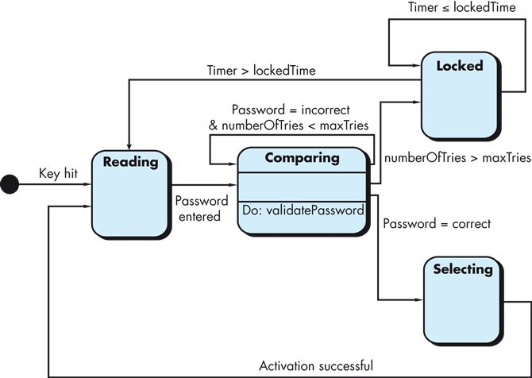
Example State Diagram
State diagram for the ControlPanel class of the SafeHome system

Slide 18
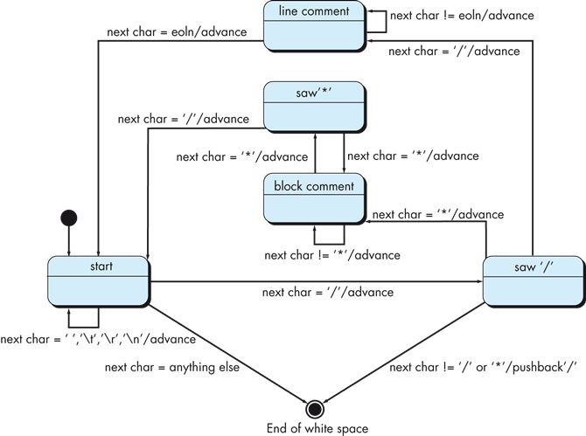
Example State Diagram
State diagram for advancing past white space and comments in Java code in a class called WhiteSpaceAndCommentEliminator

Slide 19
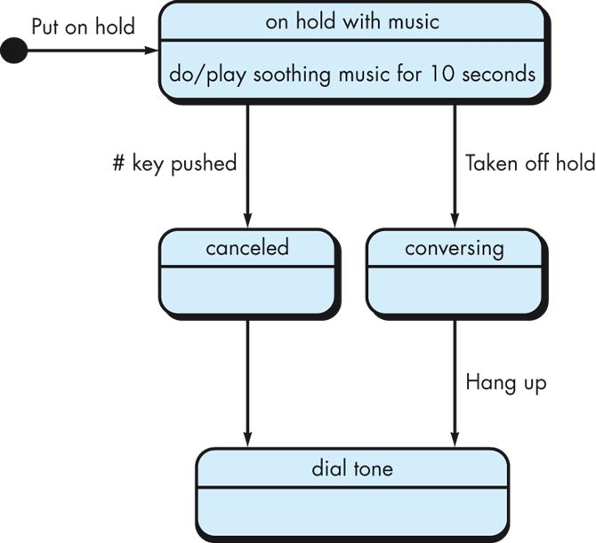
Example State Diagram
State diagram for an old hold system that plays music when you’re on hold. Notice the lack of trigger/event from the canceled state. When the # key is pushed, the call goes to the canceled state and then immediately transitions to the dial tone state.

Slide 20
Part 19
UML Activity Diagrams
The big optimizations come from refining the high-level design, not the individual routines.
- Steve McConnell, Code Complete
Notes:
This lesson introduces the basic steps in a software engineering project at a high level.
In practice, steps often overlap.

Slide 21
Learning Objectives in this Part
To understand the notation and semantics of Activity Diagrams

Slide 22
Activity Diagrams
State diagrams have been replaced in UML 2.x by Activity Diagrams
An activity diagram is used for depicting for each scenario, the flow of control with emphasis on the sequence and conditions of the flow, the activities required, the objects generated, and the synchronization points of the different paths of the flow.

Slide 23
Terminology for Activity Diagrams
Simple Process
Action
Subactivity
Complex Process
Activity diagrams look like state diagrams (i.e. state machines) with the difference that:
The state transitions occur when a process step terminates and not based on some event or message (signal)
Activity diagrams can model parallel or concurrent steps of a complex process

Slide 24
Simple Process (State)
Simple Process
Send message
Simple Process with an embedded expression
Index := lookup(e) + 7;
*
Simple parallel Processes
Send message
A activity diagram node denotes a step in a more complex process
A simple process node can not start a new complex process

Slide 25
Complex Process
Subactivity
Subactivity
*
A node denoting a complex Process, initiates by definition new processes (the embedded ones)
A complex process node is used in order to organize activity diagrams hierarchically

Slide 26
Example
aPOEmployee.sortMail
Deliver Mail
Deliver Mail
POEmployee
Check Out
Truck
Put Mail
In Boxes
sortMail()
Notes:
No standard notation yet for the name of an action, to indicate what kind of object and operation are being invoked.
No standard notation for connecting an action state to the object it invokes an operation on. Likewise for the decomposition of a subactivity state into another state machine.
The action state is polymorphic, the subactivity state is not.

Slide 27
Activity Diagram at a Method level
POEmployee.sortMail
POEmployee.deliverMail
POEmployee
PO Employee Deliver Mail Method
sortMail()
«realize»
Put Mail
In Boxes
deliverMail()
Check Out
Truck

Slide 28
Objects (Data)
ObjectName:ClassName
[ObjectState]
These activity diagram nodes denote data elements that are produced or consumed from simple or complex processes. These data elements can be at a specific state.
These type of nodes can not call or initiate processes

Slide 29
Activity Diagram with Object
Take Order
:Order
[Taken]
Fill Order
Note the use of the dashed lines when we have object nodes

Slide 30
Example
aPOEmployee.sortMail
Deliver Mail
Deliver Mail
POEmployee
Check Out
Truck
Put Mail
In Boxes
sortMail()
Notes:
No standard notation yet for the name of an action, to indicate what kind of object and operation are being invoked.
No standard notation for connecting an action state to the object it invokes an operation on. Likewise for the decomposition of a subactivity state into another state machine.
The action state is polymorphic, the subactivity state is not.

Slide 31
Initial and Final Nodes
Initial Node
Final Node
Fork and Join

Slide 32
Operators

Slide 33
Decision Points
Activity diagram edges may contain decision points. Decision points are denoted by the symbol
Calculate
Cost
[cost < $50]
Charge
Account
[cost >= $50]
Get
Authorization
Notes:
Use merge instead of dummy state before join.

Slide 34
Parallel Processes – Synchronization Points
Synchronization points denote the interaction points between parallel processes
Build
Frame
Put
On
Roof
Install
Walls
{and}
Install
Foundation
Inspect
*
*
Install
Electricity
in Foundation
{and}
Install
Electricity
In Frame
Install
Electricity
Outside
Notes:
Synch state keep track at runtime of the difference in the number of times an incoming trigger has been traversed compared to an outgoing transition. It is Petri-like in this respect.
This number can be bounded. An asterisk means no bound.
In workflow systems these are called parallel synchronized or chained processes.

Slide 35
Parallel Processes – Synchronization Points (alternative terminology)
Build
Frame
Put
On
Roof
Install
Walls
{and}
Install
Foundation
{and}
Inspect
Install
Electricity
in Foundation
{and}
Install
Electricity
In Frame
Install
Electricity
Outside

Slide 36
Synchronization Points with Objects
Object nodes as synchronization points

Slide 37
Part 20
UML Activity Diagrams - Examples
Don't reinvent the wheel, just realign it.
- Anthony J. D'Angelo
Notes:
This lesson introduces the basic steps in a software engineering project at a high level.
In practice, steps often overlap.

Slide 38
Learning Objectives in this Part
To see different examples of UML Activity Diagrams and understand their use

Slide 39
Activity Diagram Example
Customer
Telesales
Accounting
Warehouse
Request
Return
Get Return
Number
Ship Item
Receive
Item
Item
[returned]
Restock
Item
Credit
Item
Account
[available]
Notes:
Diagram assumes that:
1) Receive Item and the OFS Item can be traversed in parallel. Same for Credit Account and Item OFS.
2) Restock item will not start until its Item input has arrived.
3) State machine can terminate with hanging Item OFS.
These are natural assumptions for an object flow language, but UML is state machine based.

Slide 40
Customer
Telesales
Accounting
Warehouse
Request
Return
Get Return
Number
Ship Item
Item
Receive
[returned]
Item
Restock
Item
Credit
Item
Account
[available]

Slide 41
Example 1 – Activity Diagrams

Slide 42
Example 2 – Activity Diagrams

Slide 43
Example 3 – Activity Diagrams

Slide 44
Example 4 – Activity Diagrams

Slide 45
Your Turn
For the use case in Part 17 (class diagrams) related to Releasing a Vehicle to a customer, compile the activity diagram. Make sure you include decision nodes, fork nodes, merge nodes, join nodes, and objects with states where applicable?
Discuss the difference between merge nodes and join nodes, and between decision (choice) nodes with fork nodes in a UML activity diagram.
Give an example activity diagram where the state of an object is depicted and used in the “logic” of the corresponding use case implemented by the activity diagram.
Check-out the content of the following sites:
https://www.geeksforgeeks.org/unified-modeling-language-uml-activity-diagrams/
http://elearning.uml.ac.at/
https://www.uml-diagrams.org/activity-diagrams.html
http://www.math-cs.gordon.edu/courses/cs211/ATMExample/
https://sparxsystems.com/resources/tutorials/uml2/activity-diagram.html

